Slide 1
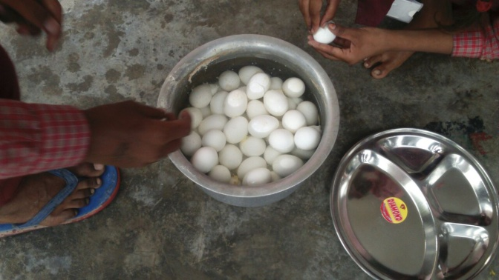
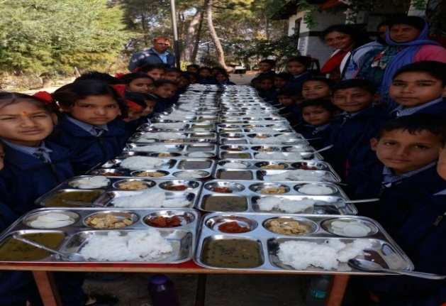
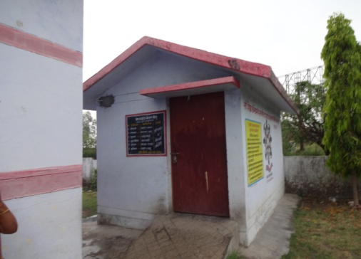
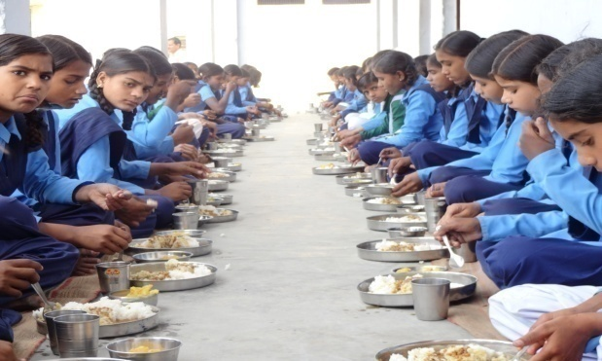
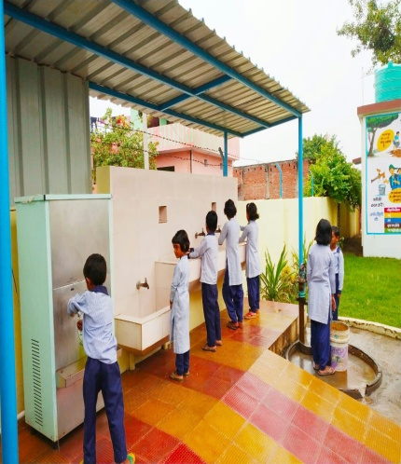
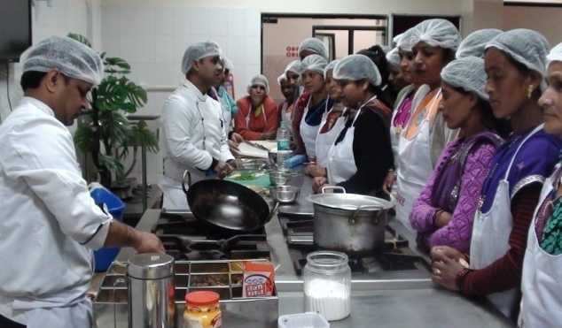
P.A.B. MEETING
2020-21
Mid Day Meal Cell
Uttarakhand

Slide 2
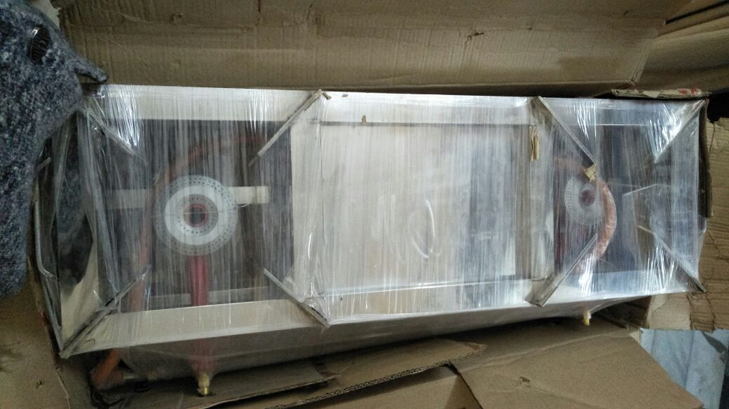
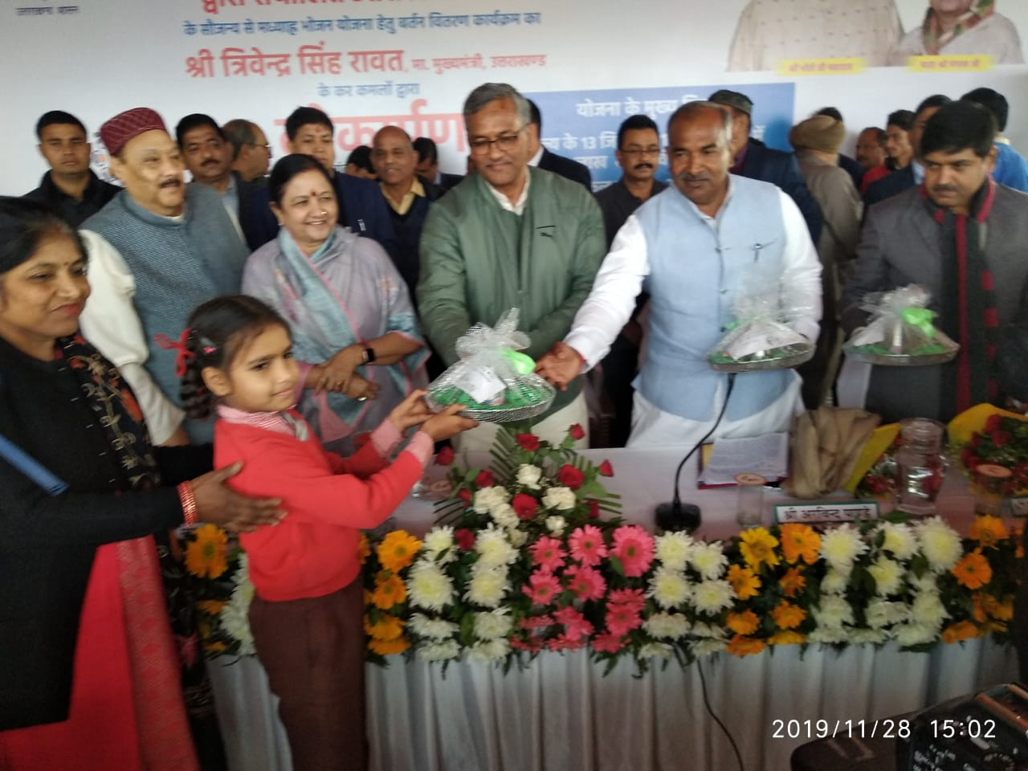
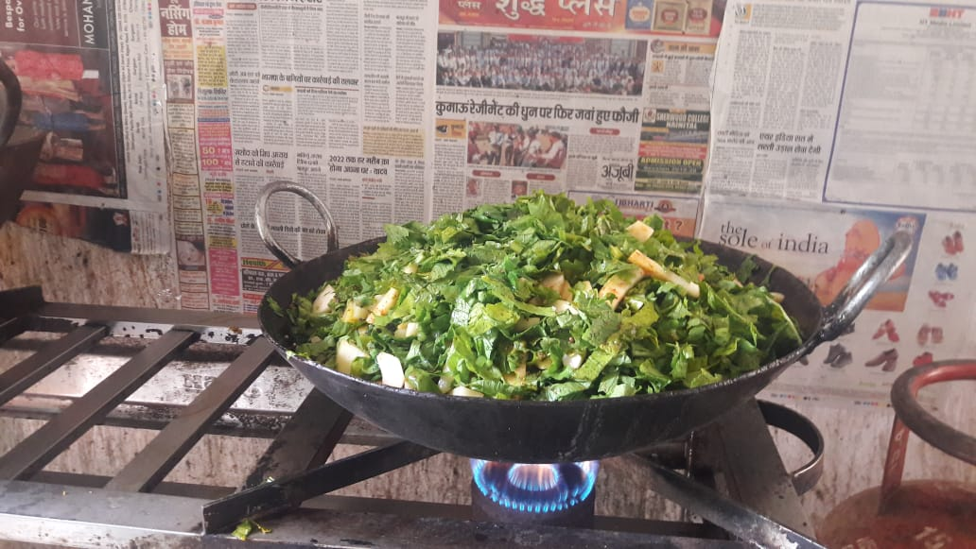
Initiatives
“The Hans Foundation” provides gas connection and gas chulhas to 5519 schools
The Hans Foundation provides Two lakh Eating Plates to 2282 schools.
Iron Kadhai
The state provides Iron Kadhai to 4169 Schools.

Slide 3
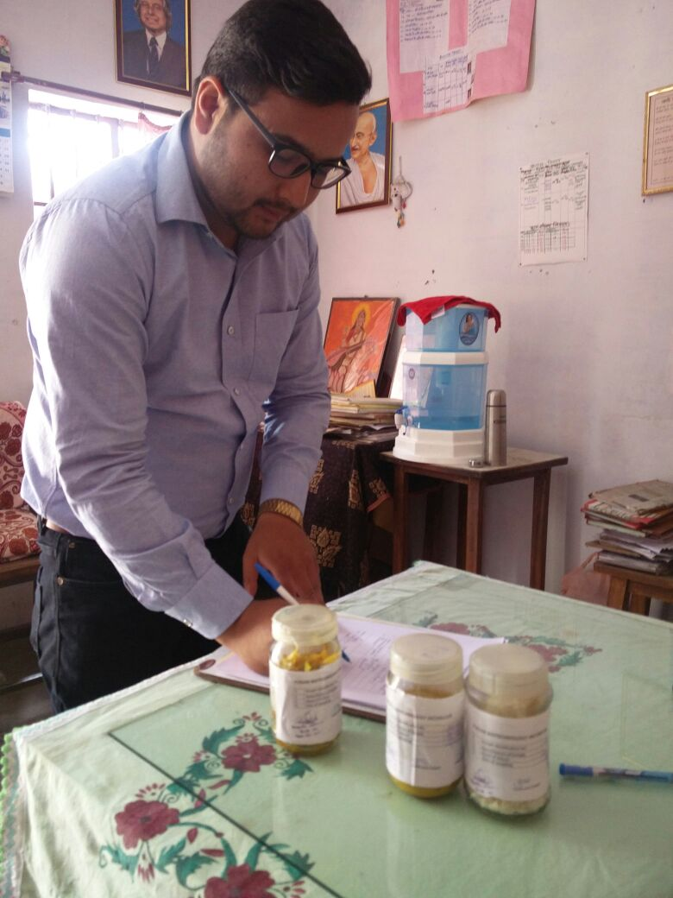
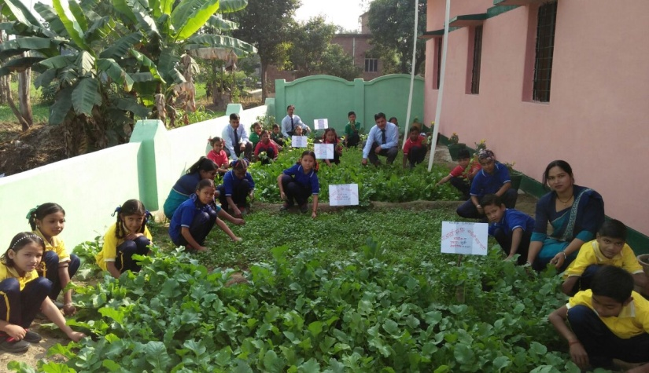
Initiatives
Food Quality Test
The MDM cell undertook a “Food Quality Testing” With the help of “Punjab Biotechnology Incubator, Mohali”. The food samples were taken from 09 schools in Haridwar and 09 Schools in Dehradun.
Kitchen Garden
At present, 1365 schools have functional Kitchen Gardens.
PS Kilkileshwar TEHRI

Slide 4
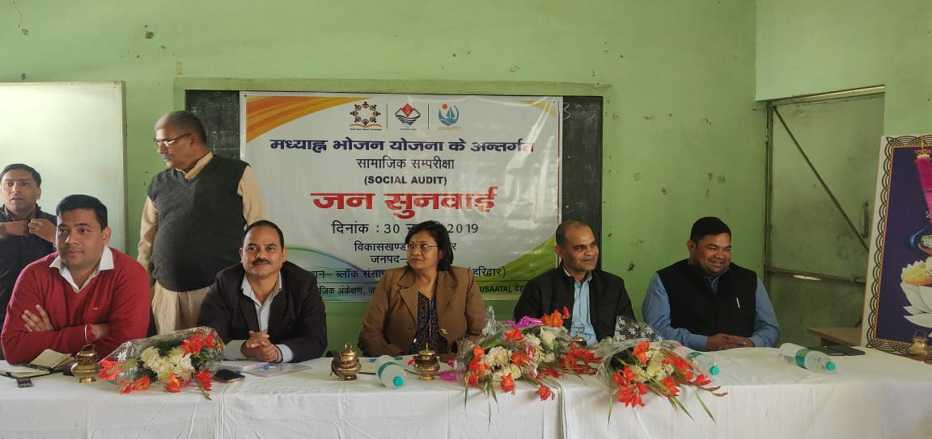
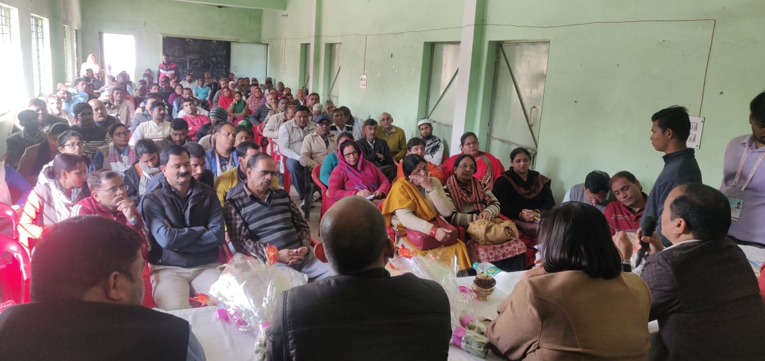
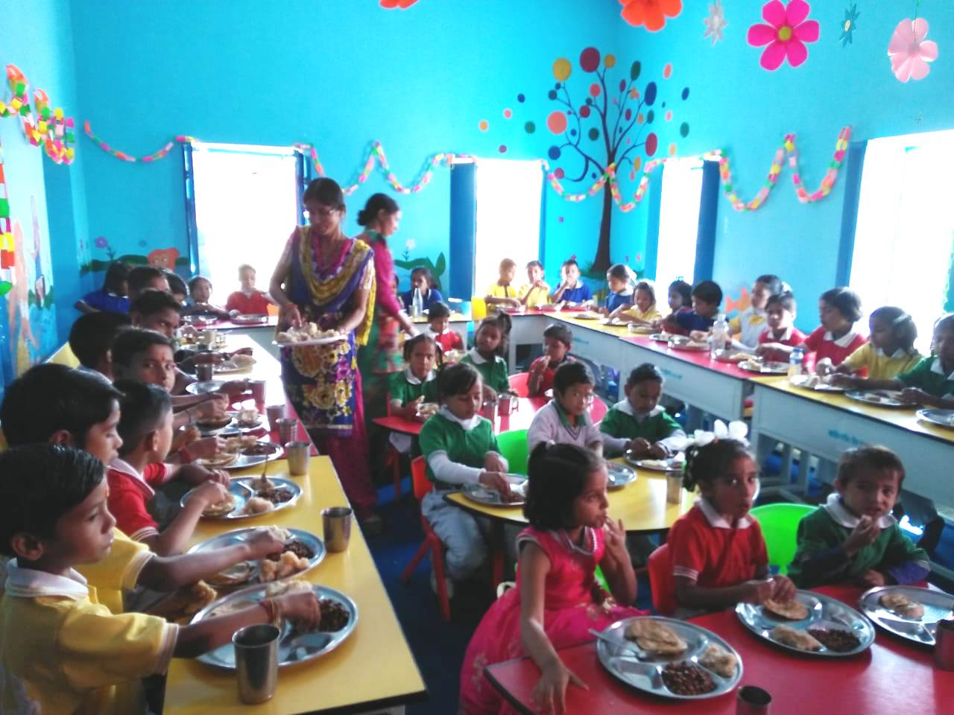
Initiatives
Social Audit -
The USAATA (Uttarakhand Social Audit, Accountability and Transparency Agency) conducted “Social Audit” of MDM Scheme in Haridwar (Narsan & Bhagwanpur) & US Nagar(Bazpur & Rudrapur).
Vishesh Bhoj-
The concept of “Vishesh Bhoj” has also been introduced in Mid Day Meal scheme, A total of 2043 schools organized Vishesh Bhoj in 2019-20.
PS Chiliyanola Almora

Slide 5
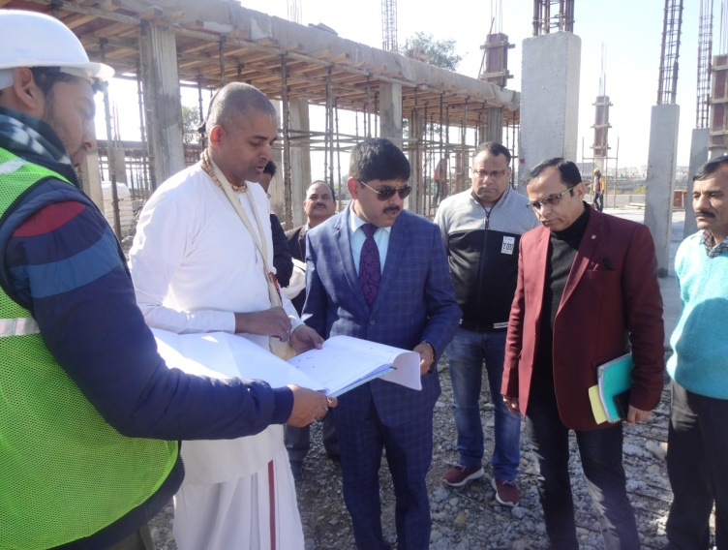
Initiatives
MDM Guidelines-
The MDM Scheme Published and distributed Guidelines to all schools.
Centralized Kitchen
The centralized kitchen construction works in 2 districts (Suddowala in Dehradun and Kashipur, Sitarganj Gadarpur in US Nagar) is in progress.
Suddhowala Dehradun

Slide 6
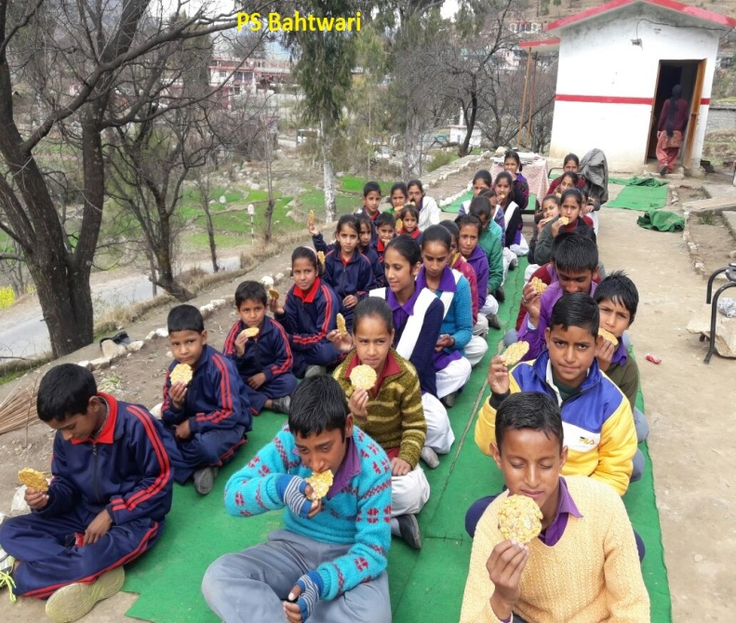
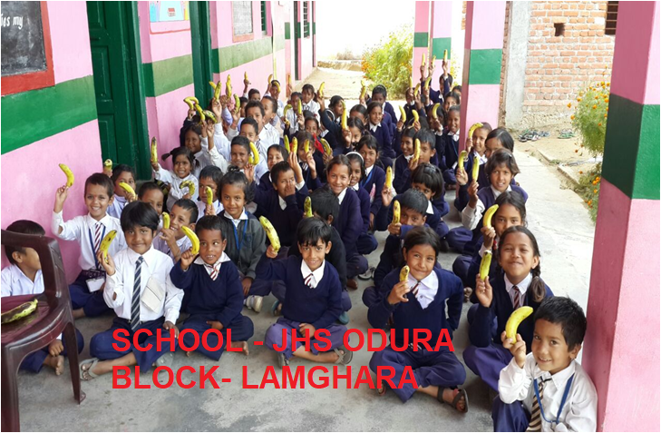
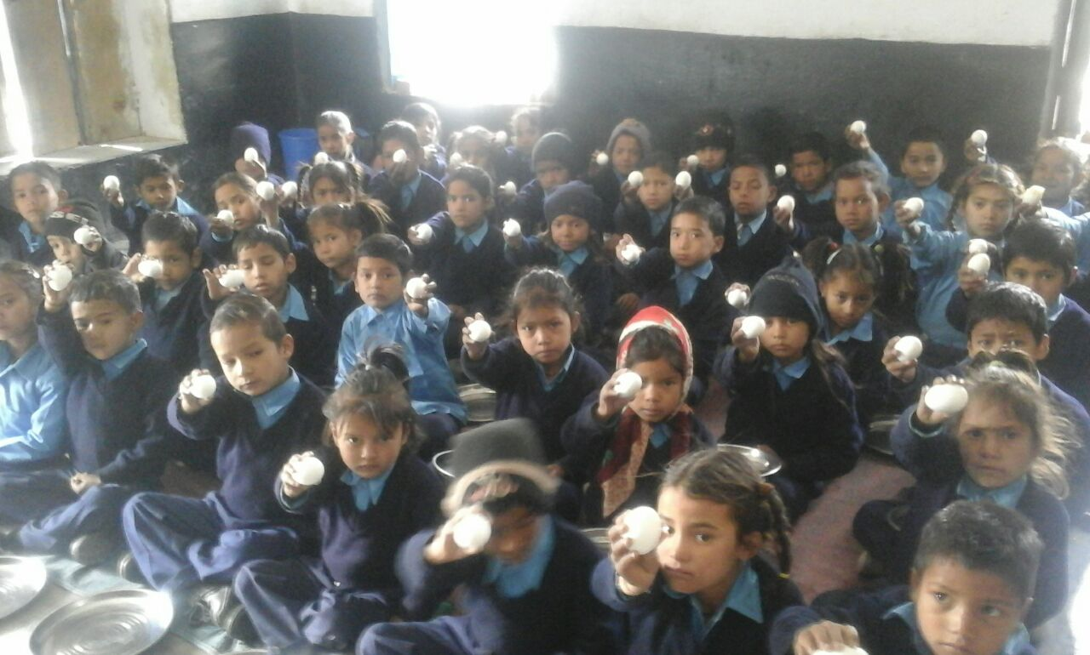
Initiatives
In addition to daily menu of MDM, additional food Items “Atirikt Poshan” for nutritional support is also provided in schools once a week(Rs 5 per child per week) that include Eggs, fruits & other nutritional items i.e.Gud Papdi, Ramdana laddu.

Slide 7
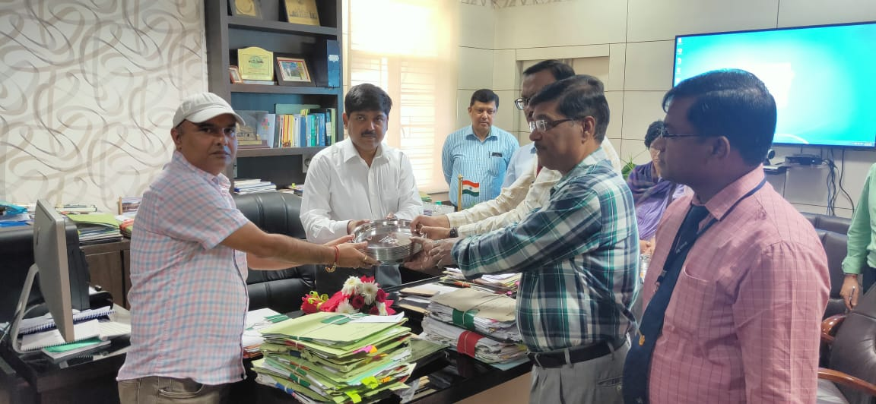
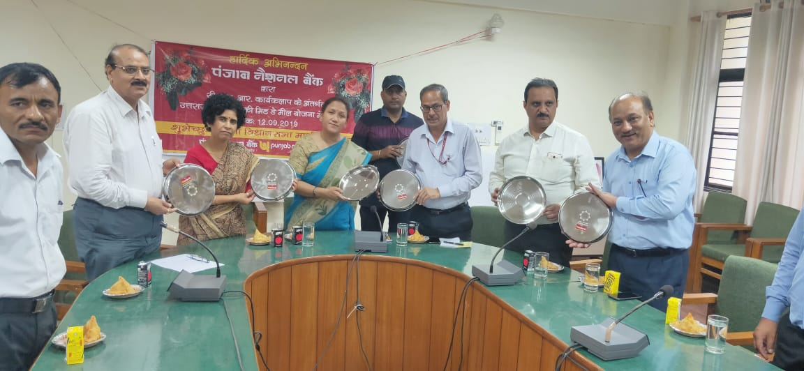
Initiatives
The Canara Bank and Punjab National Bank provides 4500 eating plates for schools under their CSR fund.

Slide 8
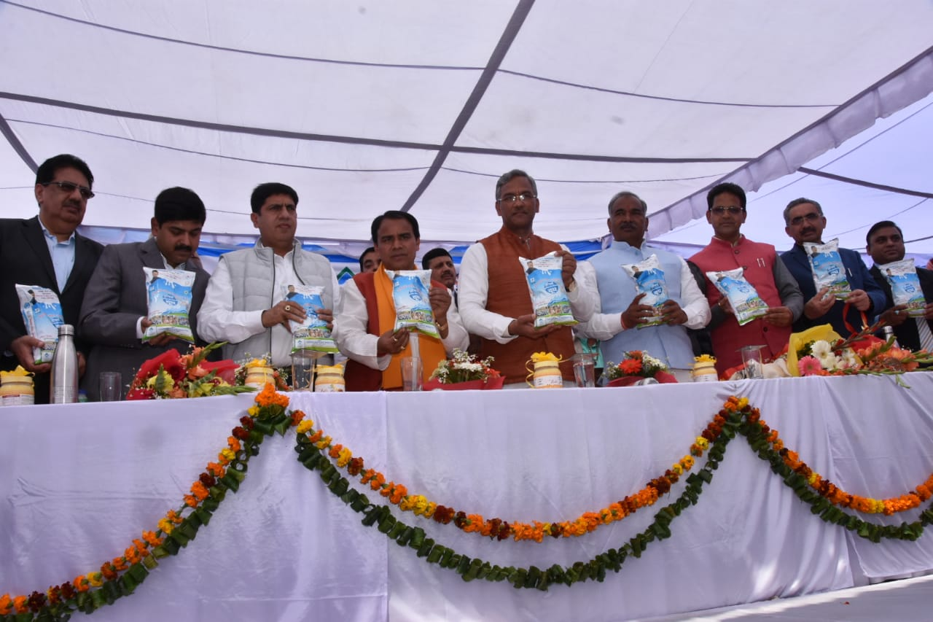
Initiatives
Mukhyamantri Anchal Amrit Yojna
The program of distribution of MILK in schools namely MUKHYAMANTRI ANCHAL AMRIT YOJNA has been launched on date 12 Mar 2020.

Slide 9
Issues
Food Security Allowance
The Annual Work Plan and Budget 2020-21 has been prepared as per the average attendance, but due to NOVEL COVID-19 as all schools were closed in the State of Uttarakhand, however Food Security Allowance has to be provided to the enrolled students in all primary and upper primary schools. As a result, it has been major difference of around 90000 students in AWP&B 2020-21 as compared to enrolled students in schools. Therefore, it is proposed to increase the cooking cost and food grains during a period of 2020-21.

Slide 10
Issues
Kitchen Cum Store
The State has an unspent balance of Unstarted kitchen cum stores of 155 units and bank interest approximate Rs. 67.11 Lakh) till date which will not be utilized under the head of kitchen cum stores in the State and will be surrendered to the Government of India.
Additionally, Government of India vide letter F.No. 1-4/2018-Desk (MDM) Dated 14th March 2019, a sum of Rs. 10000/- is approved for the kitchen cum stores constructed 10 years ago, that is, between 2006-07 to 2007-08. Accordingly, a proposal for assistance of Rs. 10000/- for repairing of 4788 units has been sent to the Government of India earlier.

Slide 11
Issues
Madarsa
There are 68 madarsas which newly recognized by the “Uttarakhand Madarsa Board” need to be approved for the financial year 2020-21. Hence the proposal has been sent to the Government of India vide letter 386/MDM/2019-20 Dated 31st August, 2019 for their approval.

Slide 12
Issues
FCI
FCI released bills of Rs 8071.48 Lac during the financial year of 2010-11 to 2016-17 and GoI released Rs. 7799.39 Lac. The shortfall of amount is Rs. 272.09 Lac. The proposal to release the additional fund (Rs. 272.09 Lac) of foodgrain for the year 2010-11 to 2016-17 was sent to GoI. After this the GoI sent Letter No. F.No.1-13/2017-EE-MDM 3-1 dated 28 Nov 2019 to request for take up the matter in MDM PAB meeting 2020-21.

Slide 13
Issues
LPG Subsidy
The Government of India provides central assistance for subsidized LPG cylinders up-to a maximum of 12. For schools where enrollment is less than 25, 12 LPG cylinders are sufficient but where the enrollment is higher, the requirement for LPG cylinders also increases. In the year 2012-13, the difference was paid by the Government of India. A proposal is being put up for providing additional funds for extra non subsidized LPG cylinders.

Slide 14
Issues
Transportation of LPG cylinders
The transportation of LPG cylinders is a big challenge in some schools which are located in far flung hilly areas and the cost increases in transporting the cylinders from delivery point to the school level. Hence, the Government of India may like to consider for provision of additional funds for the transportation of LPG cylinders from delivery point up-to the schools.

Slide 15
Institutions Covered Under MDM
Primary |  | Upper Primary |  | Total Schools (Primary & Upper Primary)
PAB Approval | MDM Served Institutions | PAB Approval | MDM Served Institutions | PAB Approval | MDM Served Institutions
In Dec 2019 (2019-20)
12045 | 11800 | 5299 | 5245 | 17344 | 17045
In Mar 2020 (2019-20)
12045 | 11800 | 5299 | 5245 | 17344 | 17045
Closed Schools
Reasons | Primary | Upper Primary | Total
Due to Zero Enrolment, Merger | 245 | 54 | 299
Notes:
Done

Slide 16
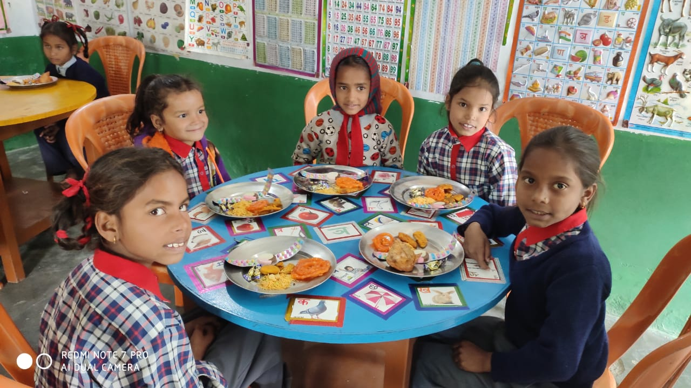
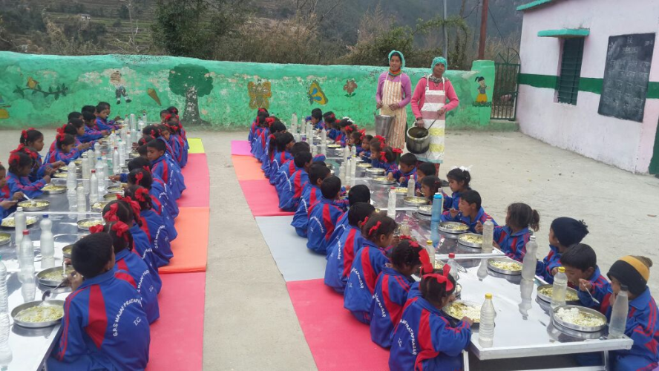
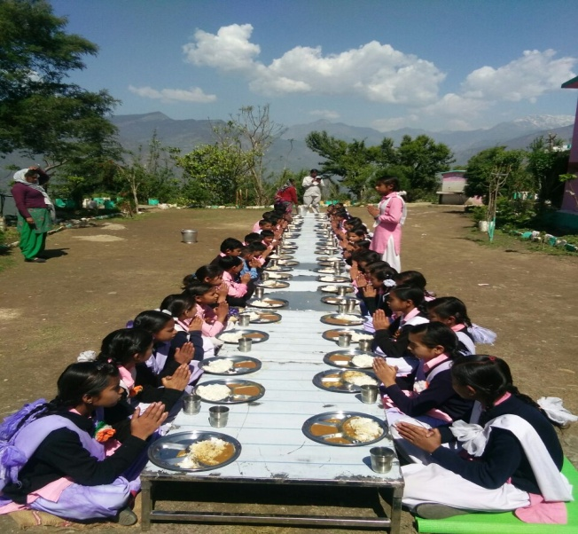
Enrollment & Beneficiaries under MDM
Primary |  |  | Upper Primary
PAB Approval | Enrollment | Beneficiaries | PAB Approval | Enrollment | Average Beneficiaries
Apr 2019-Dec 2019 (2019-20)
347250 | 404890 | 328421 | 247982 | 284416 | 229322
Apr 2019- Mar 2020 (2019-20)
347250 | 405009 | 329286 | 247982 | 284428 | 232114

Slide 17
Food grains Utilizations (In MTs)
Level | Gross Allocation by GOI (Annually) | Lifting by DSOs from FCI | Released by DSOs to Schools
2019-20 (Apr 2019-Dec 2019)
PS | 8184.12 | 6504.51 | 6100.18
UPS | 8772.45 | 7005.66 | 6380.59
Total | 16956.57 | 13510.17 | 12480.76
2019-20 (Apr 2019-Mar 2020)
PS | 8184.12 | 8172.69 | 7872.44
UPS | 8772.45 | 8742.57 | 8201.20
Total | 16956.57 | 16915.26 | 16073.64
Notes:
Done

Slide 18
FCI Payment
Level | Bills Submitted by FCI |  | Payment made to FCI
 | Quantity (In MTs) | Amount (in Lac) | Quantity (In MTs) | Amount (in Lac)
2019-20 (Apr 2019-Dec 2019)
PS | 6504.51 | 199.10 | 6014.15 | 184.16
UPS | 7005.66 | 214.34 | 6509.26 | 199.25
Total | 13510.17 | 413.44 | 12523.40 | 383.41
2019-20 (Apr 2019-Mar 2020)
PS | 8172.69 | 249.94 | 8172.69 | 249.94
UPS | 8742.57 | 267.21 | 8742.57 | 267.21
Total | 16915.26 | 517.16 | 16915.26 | 517.16

Slide 19
Health Check Up Status
Total Schools Covered | Total Children examined | Children identified with different Diseases | Children referred to nearest PHC/Hospital | No. of Spectacles distributed
Apr 2019-Mar 2020 (2019-20)
17045 | 689437 | 111680 | 15954 | 3938
Notes:
Done

Slide 20
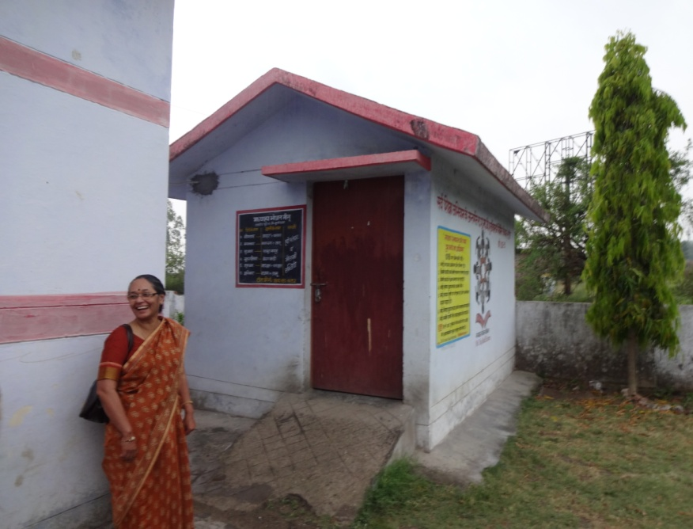
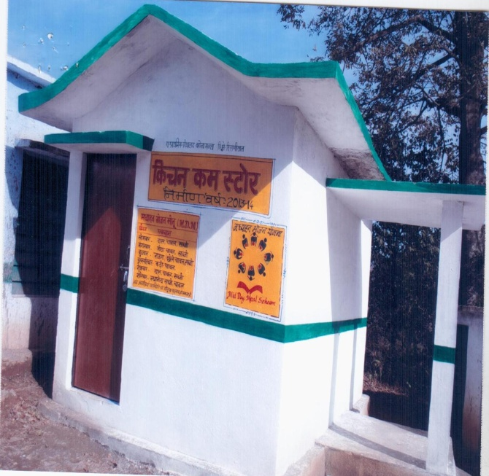
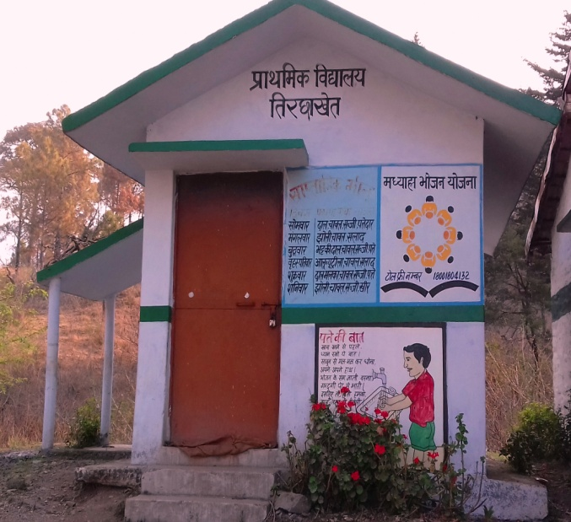
Kitchen Cum Store Progress
Total Kitchen Cum Stores sanctioned | Total Constructed | In Progress | Yet to Start | KCS Returned | Remark
Up to Mar 2020
15933 | 15698 | 47 | 54 | 134 | SLSMC has decided not to construct KS where enrolment is less than 10. Due to change in plinth area, 27 kitchen extra constructed.

Slide 21
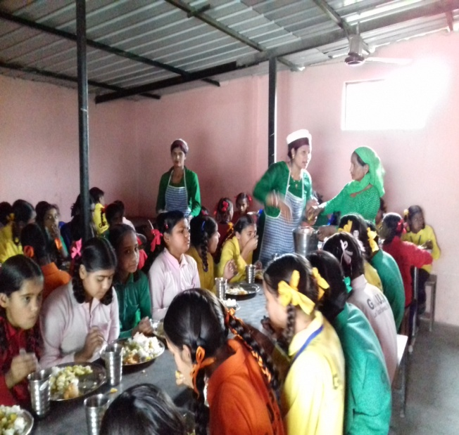
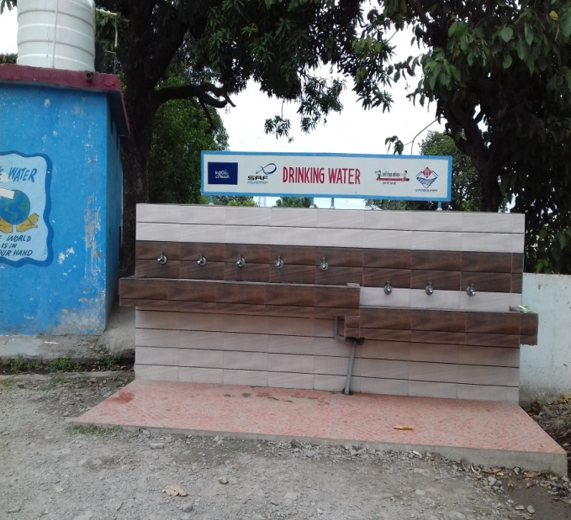
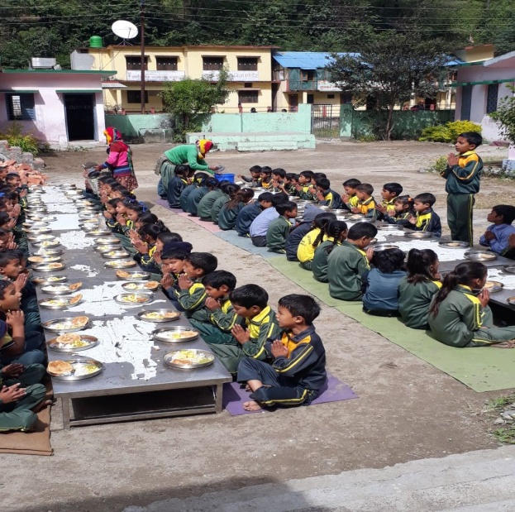
Budget Utilization (Rs. in Lac)
Total Approval | Opening Balance (Central+ State) | State Releases including Central Share | Expenditure | Total Available Amount | % Expenditure against Release+OB
Apr 2019- Dec 2019
19406.41 | 1869.54 | 12895.13 | 11307.20 | 14729.76 | 77%
Apr 2019- Mar 2020
19406.41 | 1869.54 | 15979.25 | 15602.52 | 17848.79 | 87%

Slide 22
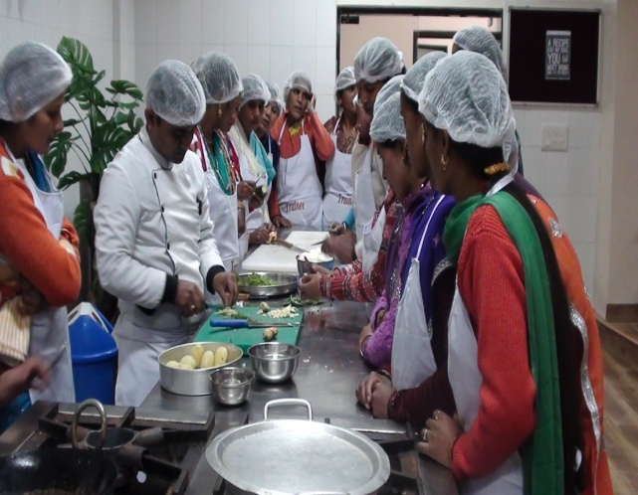
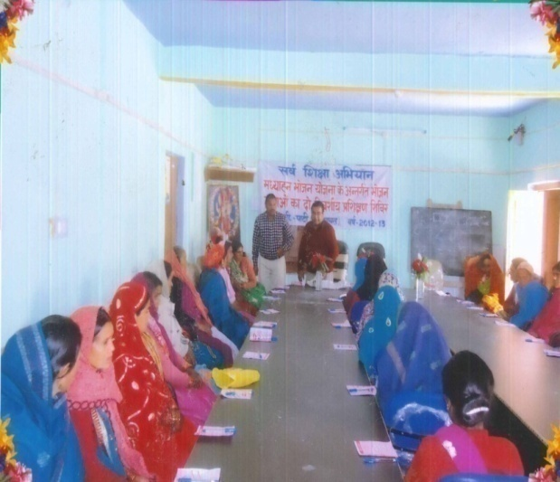
Category wise Cooks Engaged
Category | No. of Cooks
SC | 3248
ST | 1194
OBC | 5050
Minority | 592
General | 15730
Total | 25814
Meal Served By Cook Cum Helper at school
Cook Cum Helper Training At IHM Dehradun
Cook Cum Helper Training by SCERT
Notes:
Done

Slide 23
Budget Proposals
S.No. | Component |  | As per best QPR
1 | Schools | Primary | 11800
 |  | Upper Primary | 5245
2 | Children | Primary | 345577
 |  | Upper Primary | 241444
3 | Working Days | (Primary & Upper Primary) | 234
4 | Cook Cum Helper | Primary | 18777
 |  | Upper Primary | 10410
5 | Foodgrains ( MTs) | Primary | 8086.50
 |  | Upper Primary | 8474.68
6 | Kitchen Devices | New | 68
 |  | Replacement | 4228

Slide 24
Annual workplan and Budget proposal by State for 2020-21 MDM
(As per Best Quarter July-Sept 2019 + 68 Maqtab Madarsas)
Uttarakhand |  |  |  |  |  | Rs. In Lacs
S.No | Head | Level | Central Assistance | State Assistance | Total | Remark
Recurring Assistance
1 | Cooking Assistance | PS (345577 children) | 3614.67 | 404.33 | 4018.99 | @4.97 Per child/day,90:10 (4.47+0.50)
 |  | UPS (241444 children) | 3785.36 | 423.73 | 4209.09 | @7.45 Per child/day, 90:10 (6.70+0.75)
2 | Cooking Assistance (gas) | PS+UPS-(0) | 0.00 | 0.00 | 0.00
3 | Transportation (food grains) Subsidy | PS - 8086.50 MT | 203.50 | 0.00 | 203.50 | 100% GOI @ Rs. 2516.49/MTs
 |  | UPS- 8474.68 MT | 213.27 | 0.00 | 213.27
4 | Gunny bags (Khali Bore) | PS+UPS | 0.00 | 10.00 | 10.00 | Recived in state Govt. Account through Bank Challan
5 | MME | PS | 155.43 | 0.00 | 155.43 | 2.7% of Cooking Assistance,Transportation Subsidy , Honorarium of cooks & cost of foodgrains.
 |  | UPS | 140.30 | 0.00 | 140.30
6 | Honorarium of cooks | PS - 18777 | 1689.93 | 2065.47 | 3755.40 | Rs 1000 per month, 90:10, Rs 1000 additional by State Govt.
 |  | UPS - 10410 | 936.90 | 1145.10 | 2082.00
7 | Additional Honorarium of cooks | PS - 18777 | 0.00 | 375.54 | 375.54 | State Govt. is Paying additional Honorarium Rs.2000 to all cooks under MID day meal scheme
 |  | UPS - 10410 | 0.00 | 208.20 | 208.20
8 | Incentive of cooks | PS - 18777 | 0.00 | 187.77 | 187.77 | State Govt. is Paying Rs. 1000 as an incentive to all cooks under MID day meal Scheme.
 |  | UPS - 10410 | 0.00 | 104.10 | 104.10
9 | Cooks uniform | PS - 18777 | 0.00 | 187.77 | 187.77 | State Govt. is Paying additional uniform, Rs 1000 to all cooks under MID day meal Scheme
 |  | UPS - 10410 | 0.00 | 104.10 | 104.10
10 | Atirikit Poshan | PS (345577 children) | 0.00 | 673.88 | 673.88 | State Govt. is Paying additional fooditem Rs 5 to all children covered under MID day meal Scheme
 |  | UPS (241444 children) | 0.00 | 470.82 | 470.82
11 | Cost of Foodgrains (Rice) | PS - 8086.50 MT | 248.66 | 0.00 | 248.66 | @ 3000 per MT+Mandi tax@2.5%
 |  | UPS- 8474.68 MT | 260.60 | 0.00 | 260.60
12 | Cost of Foodgrains (Wheat) | PS - 0 MT | 0.00 | 0.00 | 0.00 | @ 2000 per MT+Mandi tax@2.5%
 |  | UPS- 0 MT | 0.00 | 0.00 | 0.00
13 | Salary Staff |  | 0.00 | 40.00 | 40.00 | Govt. Staff only
A | Total |  | 11248.60 | 6400.80 | 17649.40

Slide 25
Non- Recurring Assistance
1 | Kitchen cum Store | PS+UPS - (0) | 0.00 | 0.00 | 0.00 | As per Plinth area1,2,3,4, Kitchen Cum Store is being proposed
2 | Repair of kitchen cum stores constructed ten years ago | PS+UPS - () | 0.00 | 0.00 | 0.00 | @10000 Per Kitchen,90:10 (9000+1000)
3 | Kitchen Devices (New) | PS+UPS (68) | 10.04 | 1.12 | 11.15 | Unit Cost @10000 per KD for Enrolment range 1 to 50. @15000 per KD for Enrolment range 51 to 150. @20000 per KD for Enrolment range 151 to 250. @25000 per KD for Enrolment range 251 to above.
4 | Kitchen Devices (Replacement) | PS+UPS (4228) | 424.89 | 47.21 | 472.10
B | Total |  | 434.93 | 48.33 | 483.25
1 | Flexi fund @ 5% for new interventions | PS+UPS | 576.16 | 483.01 | 1059.17 | 5% of Cooking Assistance,Transportation Subsidy , MME, Honorarium of cooks & cost of foodgrains.
C | Total |  | 576.16 | 483.01 | 1059.17
 | G. Total (A+B+C) |  | 12259.69 | 6932.14 | 19191.82
No. of school days 234
Children:- Primary school 345577 ( Best Quarter coverage 339326 + 68 madarsas primary children 6251)
Upper Primary school 241444 ( Best Quarter coverage 239000 + 68 madarsas primary children 2444)

Slide 26
P h o t o gallery
Notes:
Suavere poquito

Slide 27
UPS Billekh Navin ALMORA
Vishesh bhoj
PS Naughar Garur BAGESHWAR

Slide 28
Vishesh bhoj
PS Kafal Pani TEHRI
PS Khaliyan RUDRAPRAYAG

Slide 29
Vishesh bhoj
PS Matli Dunda UTTARKASHI
Vishesh Bhoj organised by Joint Magistrate Ranikhet, in
PS MAYU MATILA TARIKHET

Slide 30
Mushroom Production in
PS Jajar Chingri
Moonakot Pithoragarh

Slide 31
Amla Pickles making in
PS Jajar Chingri
Moonakot Pithoragarh

Slide 32
PS Saunjaula Nainital
PS Devprayag Tehri
Vegetables Production in
Kitchen Garden

Slide 33
PS Bhaisuri BAGESHWAR
PS Rolyaan BAGESHWAR
Vegetables Production in
Kitchen Garden

Slide 34
Additional nutrition

Slide 35
PS Haldi US Nagar
GIC Chapradhar Tehri Garhwal
Bhojanmata Vardi
(Cooks Uniform)
UPS Teliwala Haridwar

Slide 36
Handwash

Slide 37
Iron kadhai in schools
Pithoragarh Schools

Slide 38
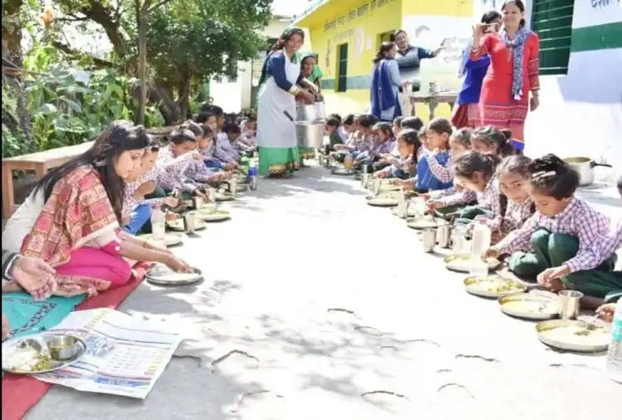
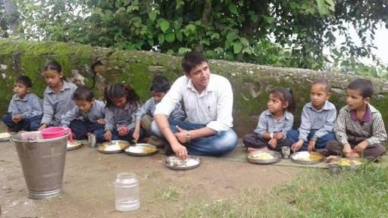
DM Chamoli
&
DM rudraprayag
enjoying
mid day meal

Slide 39
Thank You

